Slide 1
Feed Forward Neural Network
For Slides Thanks to
Dr. Nabeela

Slide 2
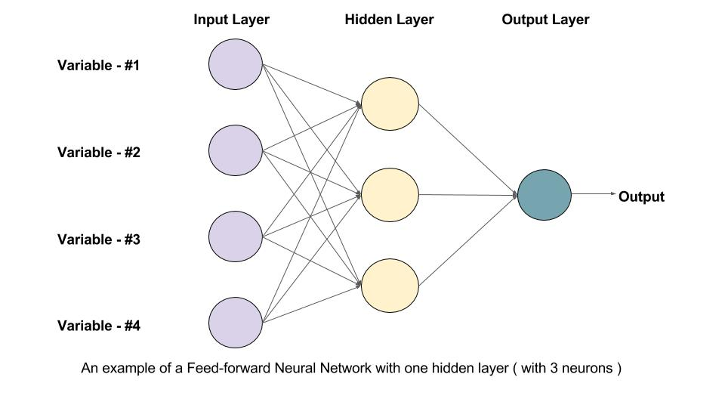

Slide 3
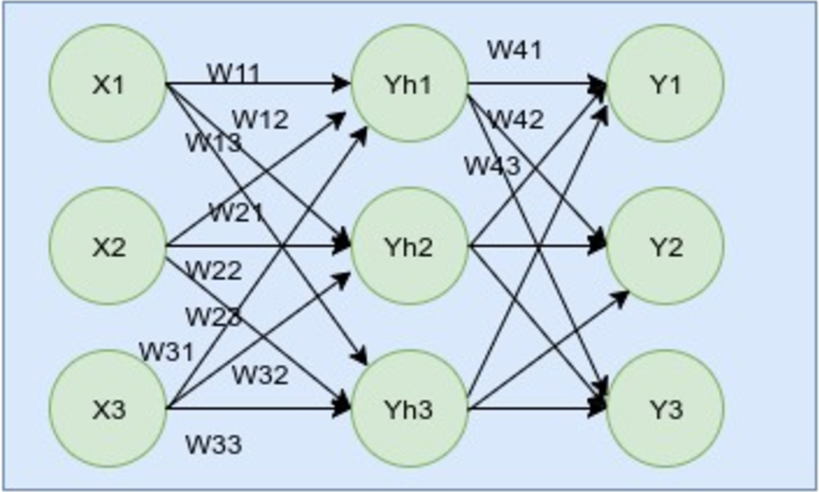

Slide 4
Inputs = X1, X2, X3
Hidden outputs = Yh1, Yh2, Yh3
Outputs = Y1, Y2, Y3
Targeted outputs = Ŷ1, Ŷ2, Ŷ3
Weights to Yh1 = W11, W12, W13
Weights to Yh2 = W21, W22, W23
Weights to Yh3 = W31, W32, W33
Weights to Y1 = W41, W42, W43
Weights to Y2 = W51, W52, W53
Weights to Y3 = W61, W62, W63

Slide 5
Now, we are all set and ready to implement the network mathematically. Every neuron has an activation function like f(x) = sigmoid(x). The activation function takes a parameter. Our first step is creating the input for the activation function. We do that by multiplying the weights by the input value. The formula looks like this:
XWh1 = X1.W11 + X2. W21 + X3. W31
XWh2 = X1.W12 + X2. W22 + X3. W32
XWh3 = X1.W13 + X2. W23 + X3. W33

Slide 6
The outputs that the hidden layers release are:
Yh1 = sigmoid(XWh1)
Yh2 = sigmoid(XWh2)
Yh3 = sigmoid(XWh3)

Slide 7
The outputs from the hidden layer become the input for the output layer and are multiplied by the weights for the output layer. Therefore, the multiplication is like this:
YhWo1= Yh1.W41+Yh2.W51+Yh3.W61
YhWo2= Yh1.W42+Yh2.W52+Yh3.W62
YhWo3= Yh1.W43+Yh2.W53+Yh3.W63

Slide 8
The final output in the output layer is like this:
Y1 = sigmoid(YhWo1)
Y2 = sigmoid(YhWo2)
Y3 = sigmoid(YhWo3)

Slide 9
Example of Deep Feed Forward Neural Network
Data pre processing
The first step is to normalize our data (known as feature scaling). We have:
Number of kilometers: quantitative, number between 0 and 350k.
Type of fuel: binary data diesel/gasoline.
Age: quantitative, number between 0 and 40.
Price: quantitative, number between 0 and 40k.

Slide 10
Forward propagation
So we have three inputs (features), one binary, two quantitatives and one quantitative output. As we will predict a quantitative variable and we will use past data to train our network, it is called a supervised model

Slide 11
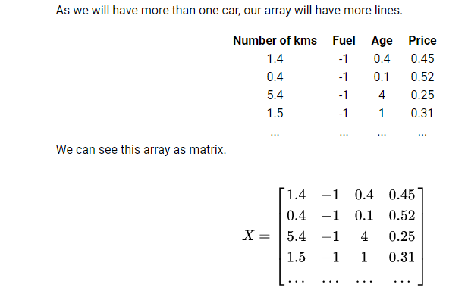

Slide 12
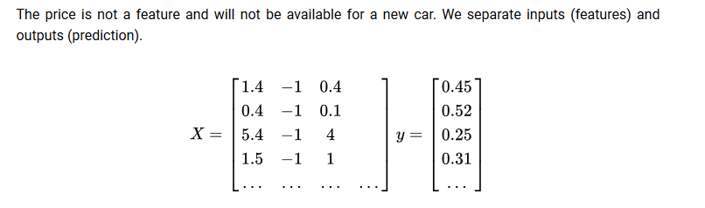
For now we have two matrices X and y, it's time to complete our network. We choose to have two hidden layers between our inputs and our output, the first layer will have three neurons and the second one two. The number of hidden layers and the number of neurons by layer is up to you. These are two hyper parameters that you have to define before running your neural network.

Slide 13
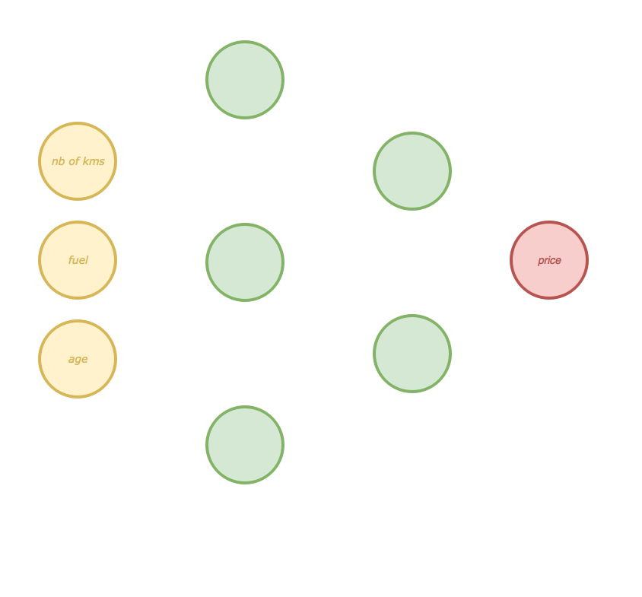

Slide 14
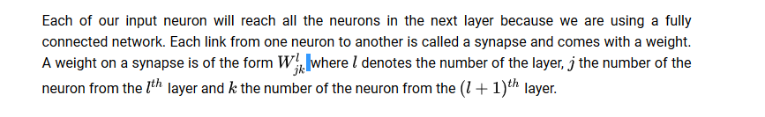
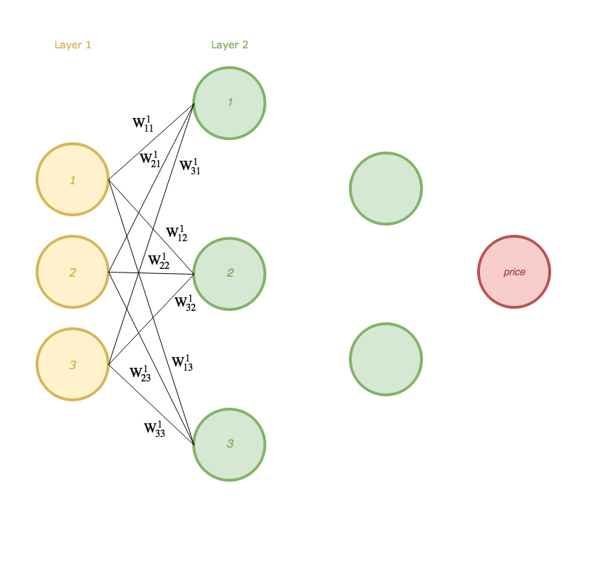

Slide 15
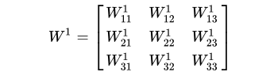
We can view the weights as a matrix.
The number of rows equals the number of features (inputs) and the number of columns equals the number of neurons in the layer number 2 . Here we have three features and the first layer has three neurons so our matrix W¹ is of the size 3x3 . For now I don't talk about the bias unit to keep things simple.

Slide 16
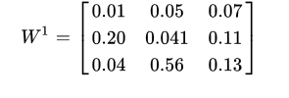
Now we compute the values of the neurons of the first hidden layer (the first column of green circles). For each car defined by three features, we will have three neurons computed for the first hidden layer. We do that using matrix calculus.
Let's say that we have only one car in our dataset. We don't need y for now.
X= [1.4 -1 0.4]
Our W¹ matrix is randomly initialized the first time so we can use random values for the weights.

Slide 17
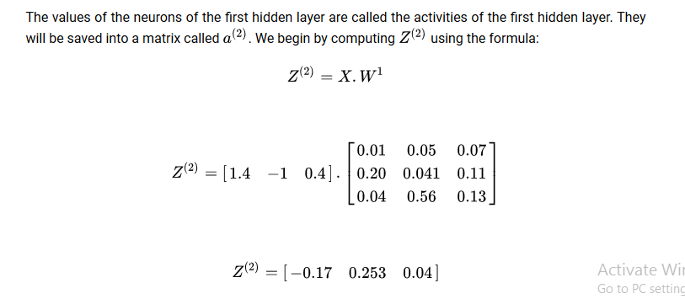

Slide 18
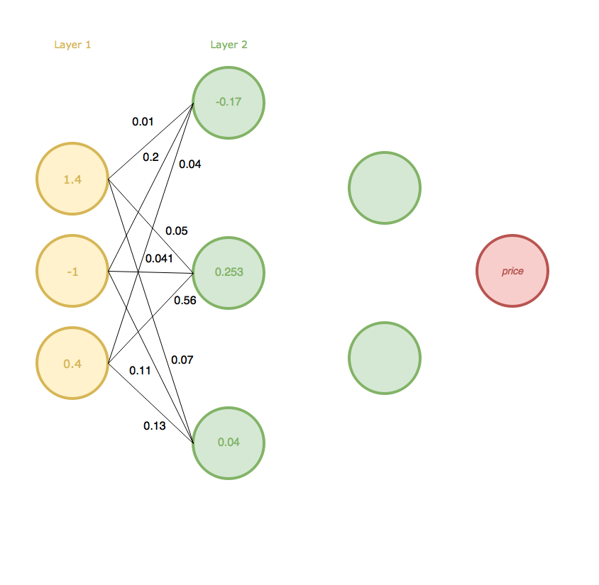
WE can view our network now as

Slide 19
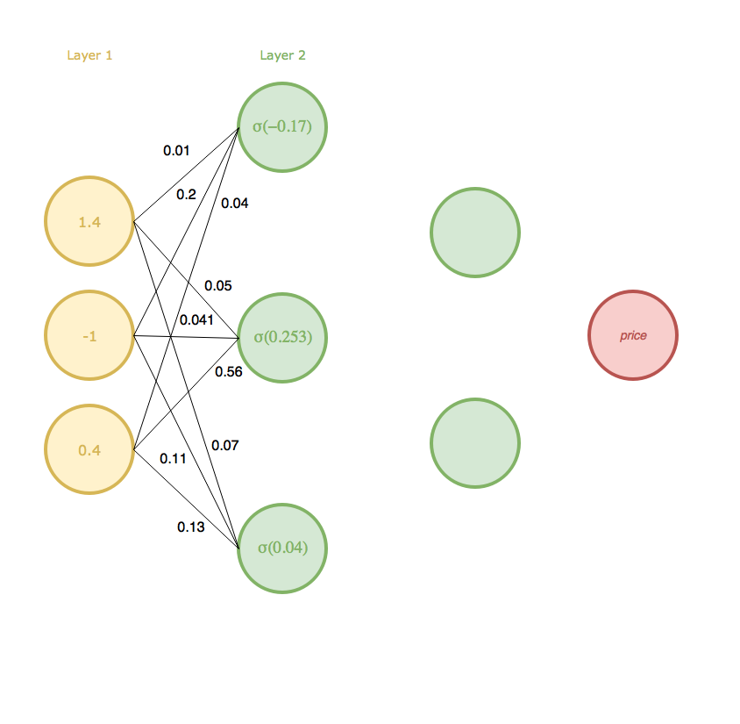
We are almost done with the first hidden layer, we just have to apply an activation function on . We can view it like that.

Slide 20
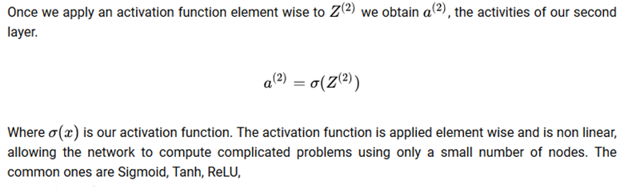

Slide 21
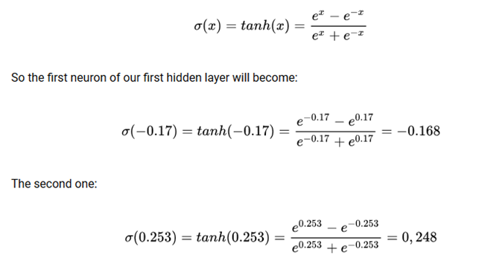
Here we are using tanh as activation function

Slide 22
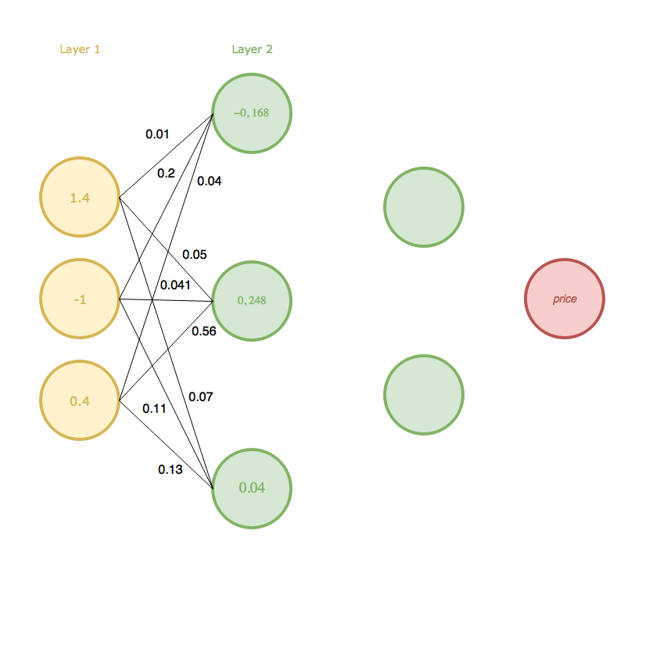
Now first hidden layer looks like this

Slide 23
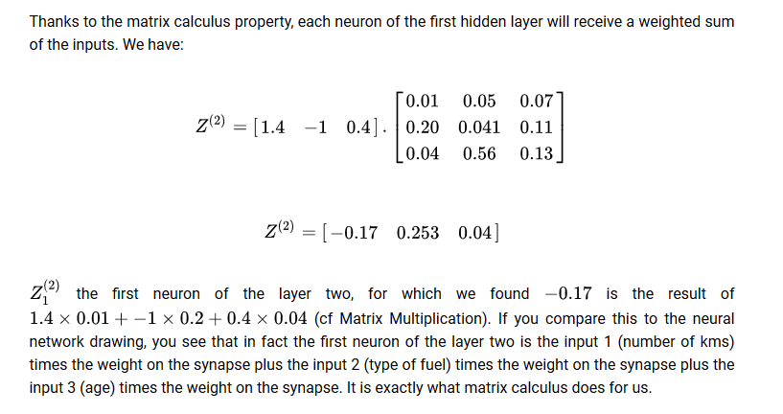

Slide 24
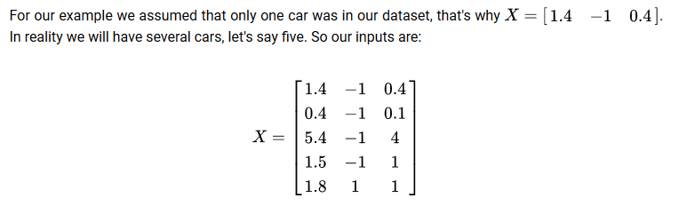

Slide 25
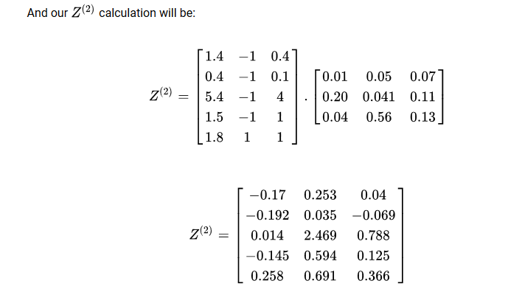

Slide 26
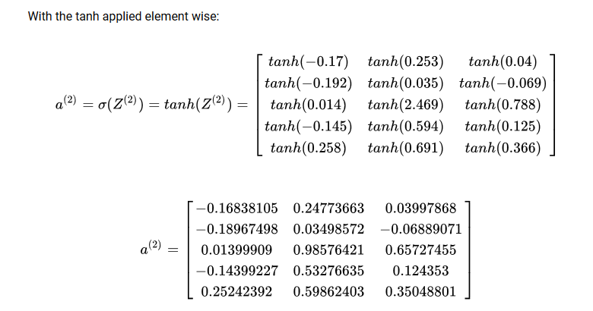

Slide 27
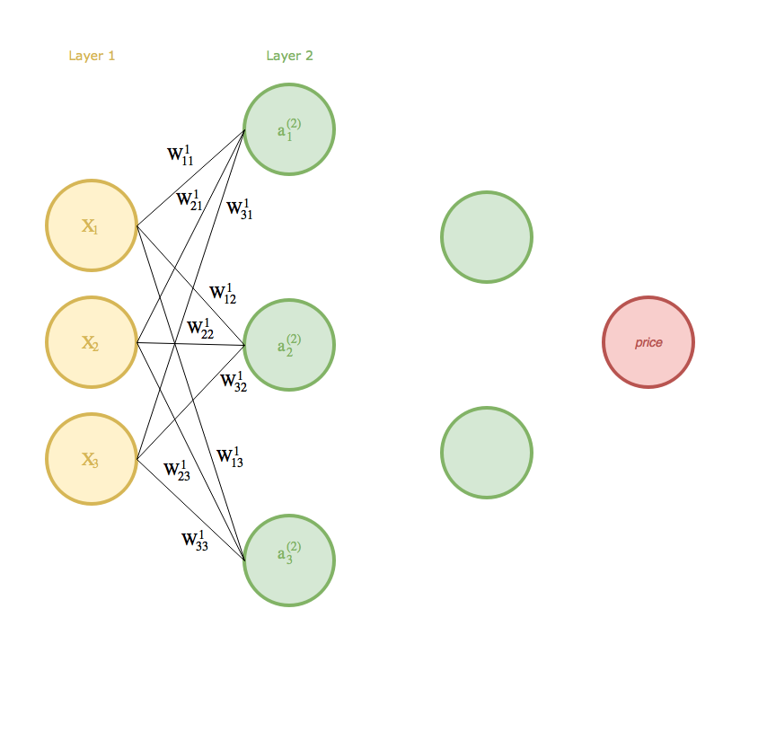

Slide 28
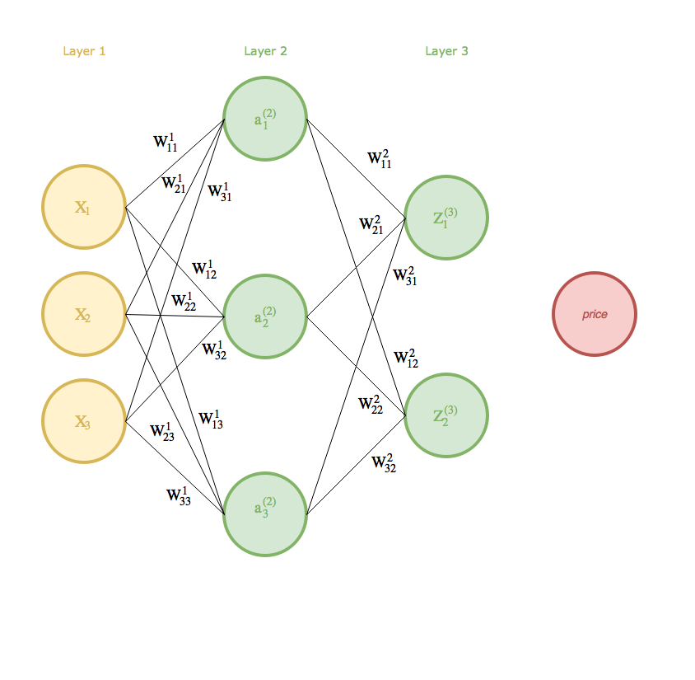

Slide 29
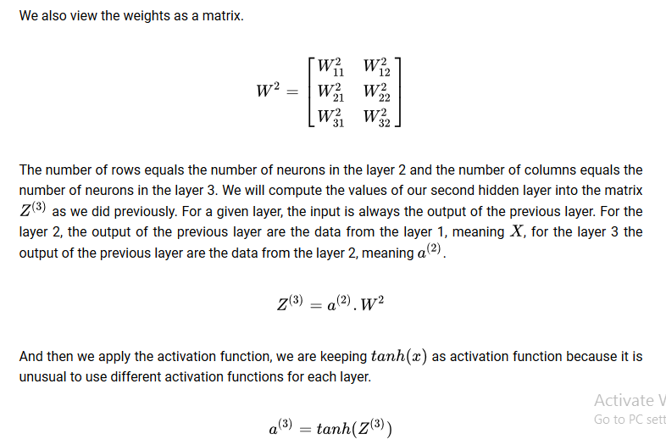

Slide 30
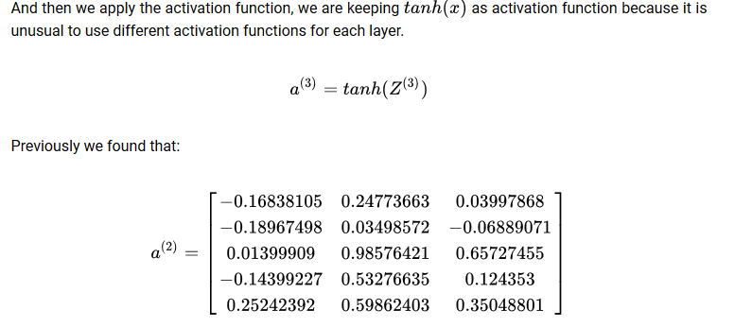

Slide 31
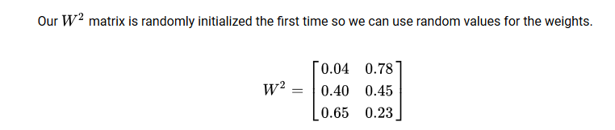

Slide 32
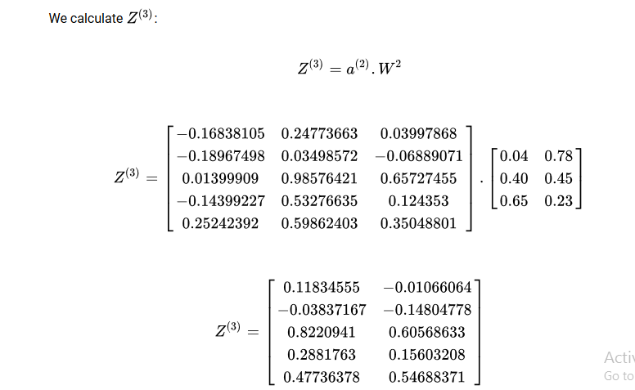

Slide 33
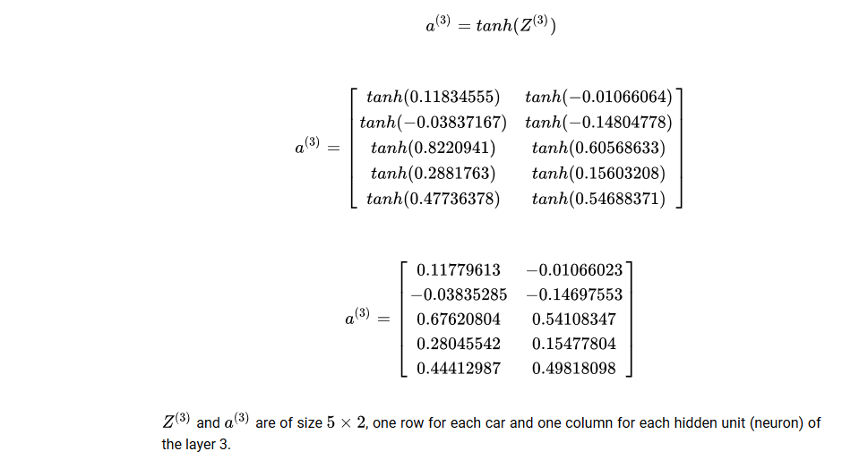
Then we apply the activation function

Slide 34
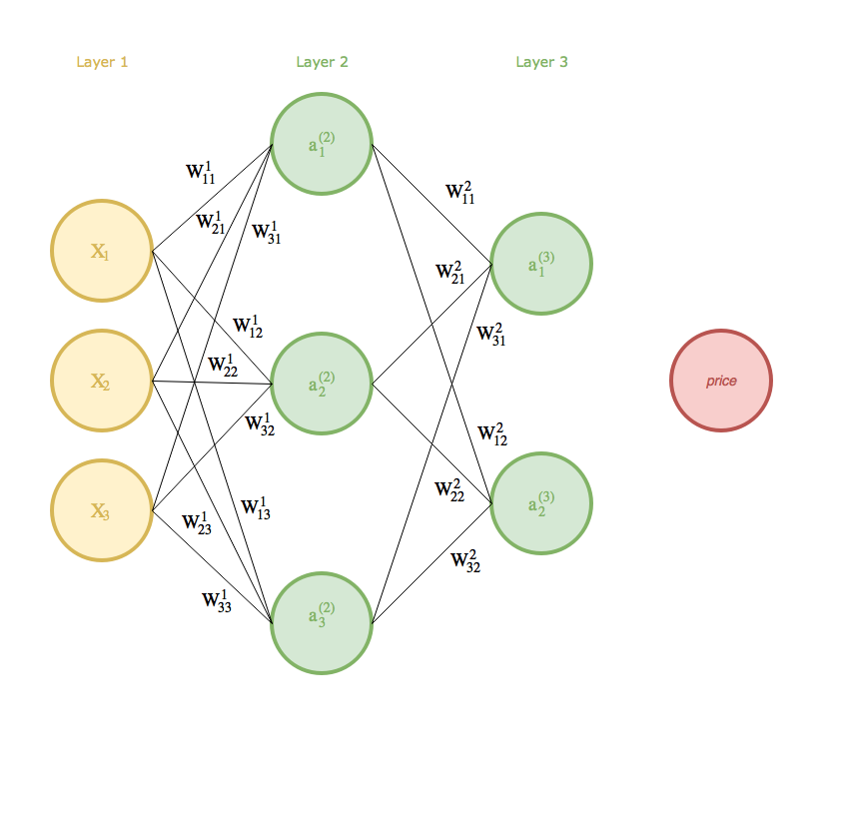
Then our function looks like this

Slide 35
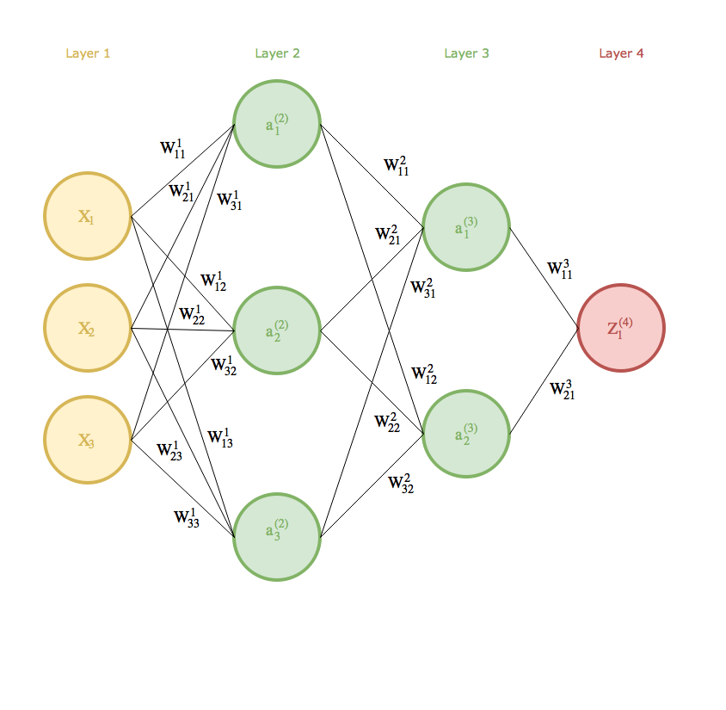
We will now connect the last layer, using the same technique as previously seen.

Slide 36
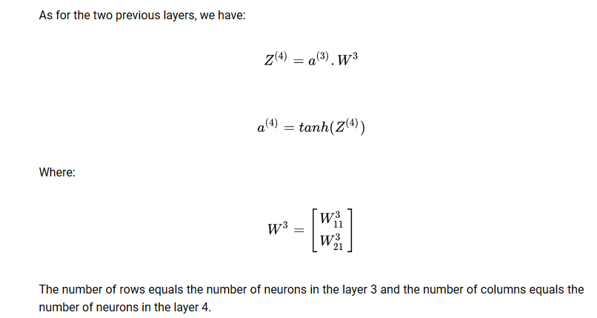

Slide 37
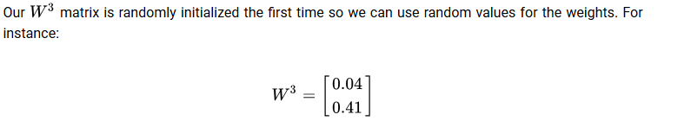

Slide 38
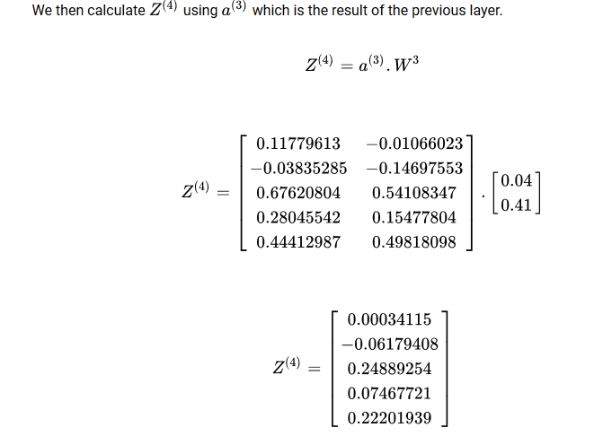

Slide 39
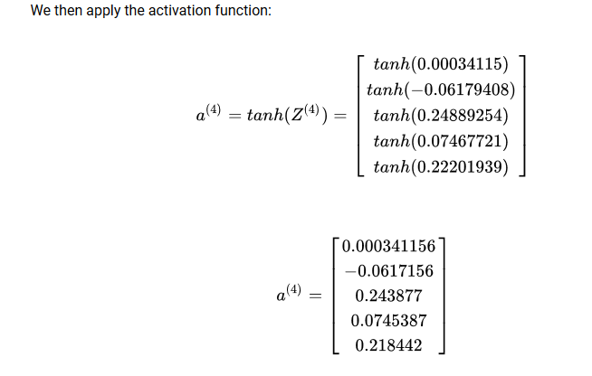

Slide 40

Finally our network looks like the following:

Slide 42
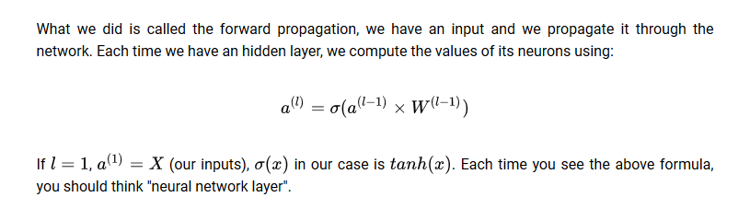

Slide 43
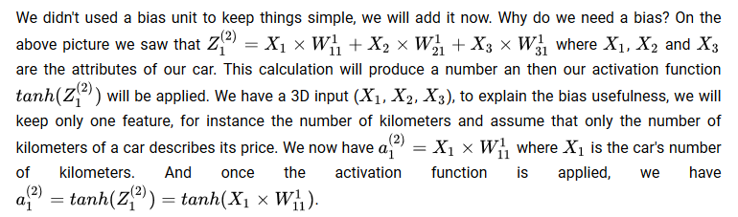
Bias

Slide 44
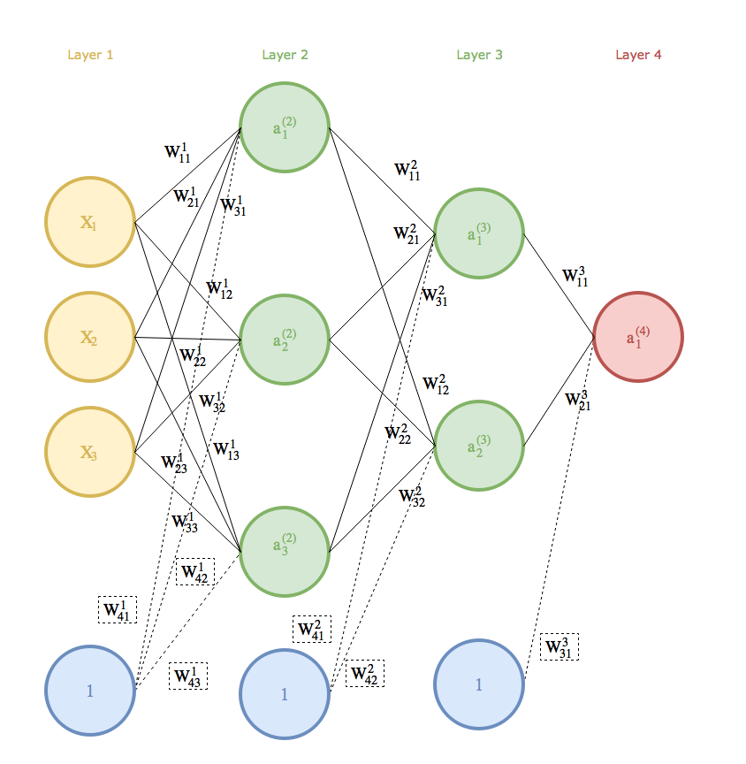

Slide 45
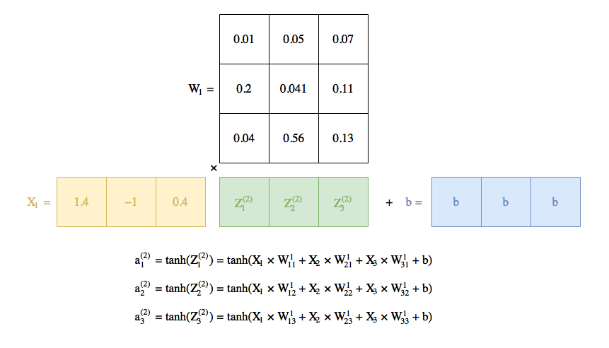

Slide 46
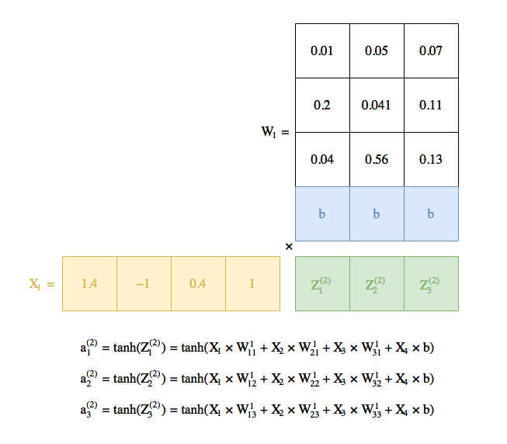
Nonetheless managing the biases and the weights in separate matrices can be cumbersome. As the biases are learned, there are not different from the weights nonetheless they should not depend of a car attributes because all the car will have different attributes whereas the biases should be the same for all the cars. The solution is to add an additional feature to each car with a value . So that this feature when multiplied with the bias will not change its value.

Slide 47
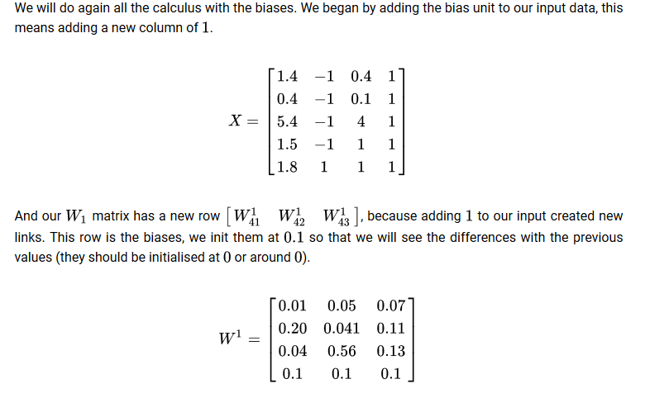

Slide 48
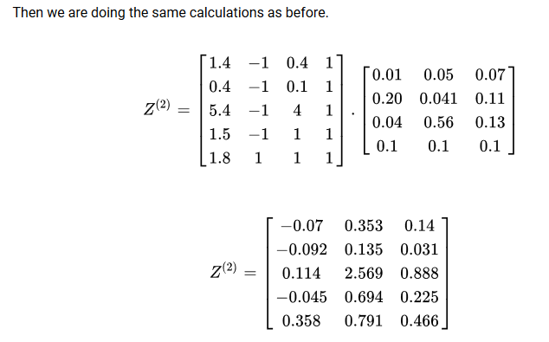

Slide 49
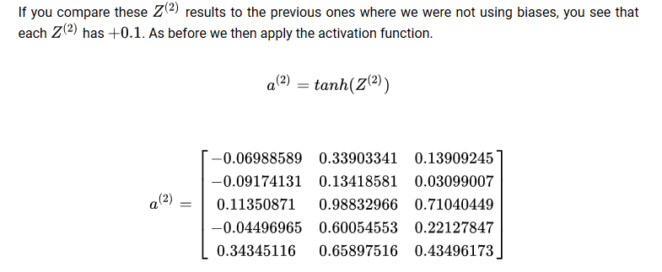

Slide 50
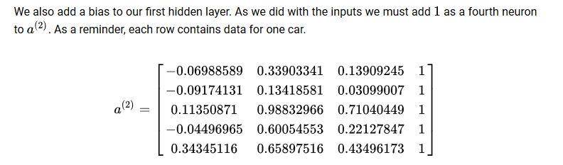

Slide 51
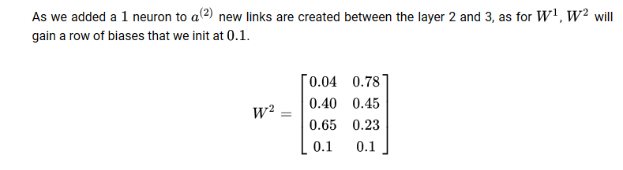

Slide 52
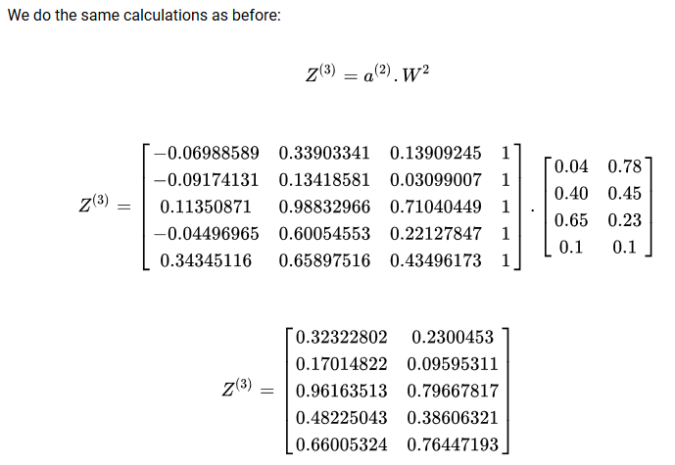

Slide 53
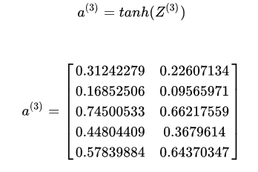

Slide 54
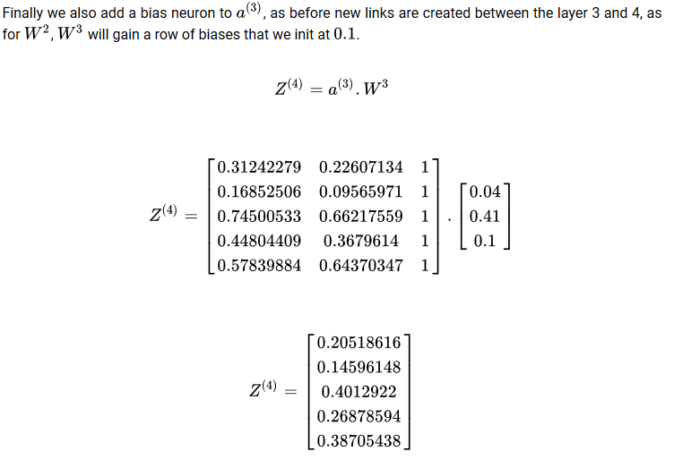

Slide 55
